Slide 1
Software Process Maturity
Mekonnen Wagaw (PhD)

Slide 2
Content
Software Process Maturity
Software maturity Framework
Principles of Software Process Change
Software Process Assessment
Process Reference Models
Capability Maturity Model (CMM), CMMI, PCMM, PSP, TSP).

Slide 3
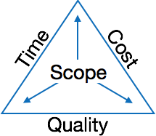
Introduction
Software project management is the art and science of planning and leading software projects.
It comprises of a number of activities, which contains planning of project, deciding scope of software product, estimation of cost in various terms, scheduling of tasks and events, and resource management.

Slide 4
…Introduction
It is extremely important for the following reasons:
Software development is highly unpredictable
Management has a greater effect on the success or failure of a project than technology advances.
Too often there is too much scrap and rework.
The entire process is very immature, not enough reuse.

Slide 5
Software Process Maturity
Software process maturity is the extent to which a specific process is explicitly defined, managed, measured, controlled, and effective.

Slide 6
Software Process maturity Framework
The framework is developed at the SEI
It addresses the five steps by characterizing a software process into one of the five maturity levels.
By establishing their organization’s position in this maturity structure, software professionals and management can more readily identify those areas where improvement actions are most likely to produce results.

Slide 7
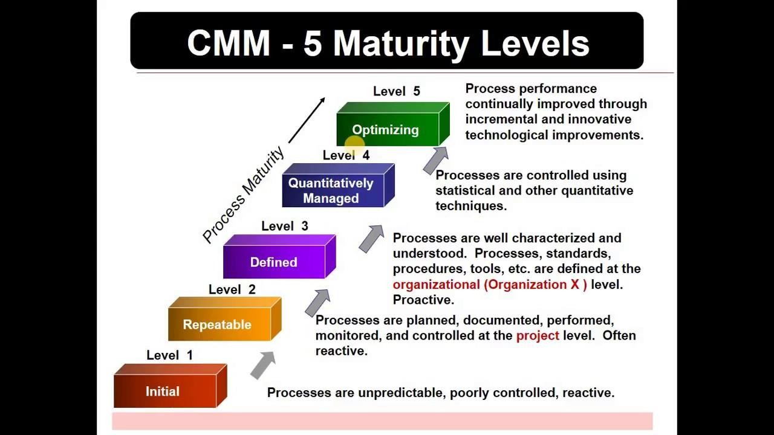
The Five Maturity Levels

Slide 8
A. Initial
It is also called “ad hoc Process”.
The organization operates without formalized procedures, cost estimates, and project plans.
If there are any formal procedures for project control, there is no management mechanism to ensure they are used.
The best test to observe how such an organization behaves in a crisis is, abandoning established procedures and reverting to merely coding and testing.

Slide 9
…Initial
Organizations at this level can improve their performance by instituting basic project controls.
The most important are:
Project management
Management oversight
Quality assurance
Change control

Slide 10
Project management
The fundamental role of a project management system is to ensure effective control of commitments which requires adequate preparation, clear responsibility, a public declaration, and a dedication to performance.
In any project, a plan must be developed to determine the best schedule and the resources required.
In the absence of such an orderly plan, no commitment can be better than an educated guess.

Slide 11
Management oversight
A disciplined software development organization must have senior management oversight that review and approve all major plans before official commitment.

Slide 12
Quality assurance
A quality assurance group is charged with assuring management that the software development work is actually done the way it is supposed to be done.
To be effective, the assurance organization must have an independent reporting line to senior management and sufficient resources to monitor performance of all key planning, implementation, and verification activities.

Slide 13
Change control
To develop quality software on a predictable schedule, the requirements must be maintained with reasonable stability throughout the development cycle.
Changes will have to be made, but must be managed and introduced in an orderly way.

Slide 14
B. Repeatable
The organization has achieved a stable process with a repeatable level of statistical control by initiating rigorous project management of commitments, cost, schedule, and changes.
This process has one important strength over the initial process i.e. It provides commitment control.

Slide 15
… Repeatable
Organizations at this level face major risks when they are presented with new challenges.
Examples of the changes that represent the highest risk are:
It is possible for a new technology to do more harm than good, if there is no defined process framework.
When the organization must develop a new kind of product, it is entering new territory. These changes can be disruptive.
In this level, a new manager has no orderly basis for understanding what is going on and new team members must learn the ropes through word of mouth.

Slide 16
… Repeatable
The key actions required to advance from the Repeatable Process to the Defined Process are:
Establish a process group which is a technical group that focuses exclusively on improving the software
developing process. The responsibilities of process groups include:
Defining the development process,
Identifying technology needs and opportunities,
Conducting quarterly management that reviews process status and performance.

Slide 17
… Repeatable
Establish a software-development process architecture that describes the technical and management activities required for proper execution of the development process. The architecture is a structural decomposition of the development cycle into tasks, each of which has entry criteria, fundamental descriptions, verification procedures, and exit criteria.
If they are not already in place, introduce a family of software-engineering methods and technologies.

Slide 18
C. Defined
To ensure consistent implementation and provide a basis for better understanding of the process, the organization has defined the process.
At this point that the organization achieved the foundation for major and continuing progress, advanced technology can usefully be introduced.
The development group, when faced with a crisis, will likely continue to use the Defined Process.

Slide 19
… Defined
The foundation has now been established for examining the process and deciding how to improve it.
As powerful as this step is, it is still only qualitative:
There is little data to indicate what is going on or how effective the process really is.
There is considerable debate about the value of software process measurements and the best ones to use.
This uncertainty stems from a lack of process definition and the consequent confusion about the specific items to be measured. With a defined process, we can focus the measurements on specific tasks

Slide 20
… Defined
The key steps to advance to the Managed Process are:
Establish a minimum, basic set of process measurements to identify the quality and cost parameters of each process step. The objective is to quantify the relative costs and benefits of each major process activity, such as the cost and yield of error detection and correction methods.
Establish a process database with the resources to manage and maintain it. Cost and yield data should be maintained centrally to guard against loss, to make it available for all projects, and to facilitate process quality and productivity analysis.

Slide 21
… Defined
Provide sufficient process resources to gather and maintain this data and to advise project members on its use.
Assign skilled professionals to monitor the quality of the data before entry in the database and to provide guidance on analysis methods and interpretation.
Assess the relative quality of each product and inform management where quality targets are not being met.
An independent quality-assurance group should assess the quality actions of each project and track its progress against its quality plan.
When this progress is compared with the historical experience on similar projects, an informed assessment generally can be made.

Slide 22
Managed
The organization has initiated comprehensive process measurements, beyond those of cost and schedule performance. This is when the most significant quality improvements begin.
The greatest potential problem with the Managed Process is the cost of gathering data.
There are many number of potentially valuable measures of software development and support, but such data is expensive to gather and maintain.
Process data must not be used to compare projects or individuals. Its purpose is to illuminate the product being developed and to provide an informed basis for improving the process.

Slide 23
…Managed
The followings are two fundamental requirements to advance from the Managed Process to the Optimizing Process:
Support automatic gathering of process data. Some data cannot be gathered by hand, and all manually gathered data is subject to error and omission.
Analyzing and modifying the process by using this data to prevent problems
and improve efficiency.

Slide 24
Optimizing
The Process Optimization goes on at all levels of process maturity.
However, with the step from the Managed to the Optimizing Process, there is a paradigm.
Up to this point, software development managers have largely focused on their products and will gather and analyze data that directly relates to product improvement.
In the Optimizing Process, the data is available to actually tune the process itself.

Slide 25
…Optimizing
With a little experience, management will see that process optimization can produce major quality and productivity improvements.
For example, many errors can be identified and fixed far more economically by code inspections than through testing.
It takes about one to four working hours to find and fix a bug through inspections and about 15 to 20 working hours to find and fix a bug in a function or system test.

Slide 26
…Optimizing
It is thus clear that testing is not a cost-effective way to find and fix most bugs.
But it would be unwise to eliminate testing completely because it provides a useful check against human errors.
In the optimizing process, the organization has the means to identify the weakest elements of the process and fix them, the data is available to justify the application of technology to various critical tasks.
The Optimizing Process provides a disciplined environment for professional work. Discipline is required in large software projects to ensure, for example, that the people involved use the same conventions, don’t damage each other’s products, and properly synchronize their work.

Slide 27
There is little data on how long it takes for software organizations to advance through these maturity levels toward the Optimizing Process. Based on author’s experience, transition from level 1 to level 2 or from level 2 to level 3 takes from one to three years, even with a dedicated management commitment to process improvement. To date, no complete organizations have been observed at levels 4 or 5.
How to use this framework? This process-maturity structure is intended to be used with an assessment methodology and a management system. Using this framework, the SEI has developed an assessment questionnaire and methodology.

Slide 28
II. Principles of Software Process Change
The basic principles of software change are
Automation of Poorly Defined. The process will produce Automation of poorly defined results
Improvement should be made in small steps.
Educate / Train again & again.

Slide 29
…Principles
The Software Process management has two key areas.
People:
A Good mix of Talent is required
The best people are always in short supply.
With Proper leadership, education, training & support, most people can do better that what currently doing.
Design Methods:
Quality product = Domain Knowledge + ability to produce the good design

Slide 30
Six basic principles of Software Process change
Major changes to software process must start at top.
It requires leadership
Managers should provide good leadership, get good priorities, continue support.
Everyone must be involved.
Within an unmatured software process, Software professionals are forced to improvise solutions
In mature process, these individual actions are structured and efficient.
Need to repair the process, not the people.
Effective changes require the team to have common goals and knowledge of current process.
Assessment is effective way to gain this.
Professionals need more help in controlling Requirements, Plans, coding with system design issues.

Slide 31
…Six
Change is continuous.
Prevention is better than recovery.
Every defect is an improve opportunity
Relative changes generally make things worse.
Software process changes will not be retained without conscious effort & periodic Re-enforcements.
Precise and accurate work is so hard
Software process improvement requires investment.
Someone must work in improvement
Unplanned process improvement is wishful thinking.

Slide 32
III. Software Process Assessment
A software process assessment is a disciplined examination of the software processes used by an organization, based on a process model.
The assessment includes
the identification and characterization of current practices,
identifying areas of strengths and weaknesses, and
the ability of current practices to control or avoid significant causes of poor (software) quality, cost, and schedule.

Slide 33
…Process Assessment
A software assessment can be of three types.
A self-assessment (first-party assessment) is performed internally by an
organization's own personnel.
A second-party assessment is performed by an external assessment team or the organization is assessed by a customer.
A third-party assessment is performed by an external party.
Software process assessments are performed in an open and collaborative environment.

Slide 34
Software Process Assessment Cycle
The CMM-based assessment approach uses a six-step cycle.
Select a team - The members of the team should be professionals knowledgeable in software engineering and management.
The representatives of the site to be appraised complete the standard process maturity questionnaire.
The assessment team performs an analysis of the questionnaire responses and identifies the areas that warrant further exploration according to the CMM key process areas.

Slide 35
…Assessment Cycle
The assessment team conducts a site visit to gain an understanding of the software process followed by the site.
The assessment team produces a list of findings that identifies the strengths and weakness of the organization's software process.
The assessment team prepares a Key Process Area (KPA) profile analysis and presents the results to the appropriate audience.

Slide 36
…Assessment Cycle
With regard to data collection, there are four methods:
The standard maturity questionnaire
Individual and group interviews
Document reviews
Feedback from the review of the draft findings with the assessment participants

Slide 37
Standard CMMI Assessment Method for Process Improvement (SCAMPI)
SCAMPI was developed to satisfy the CMMI model requirements.
It consists of three phases:
Plan and preparation
Conduct the assessment onsite
Report results

Slide 38
… SCAMPI
The activities for the plan and preparation phase include
Identify the assessment scope
Develop the assessment plan
Prepare and train the assessment team
Make a brief assessment of participants
Administer the CMMI Appraisal Questionnaire
Examine the questionnaire responses
Conduct an initial document review

Slide 39
…SCAMPI
The activities for the onsite assessment phase include:
Conduct an opening meeting
Conduct interviews
Consolidate information
Prepare the presentation of draft findings
Present the draft findings
Consolidate, rate, and prepare the final findings

Slide 40
…SCAMPI
The activities of the reporting results phase include:
Present the final findings
Conduct an executive session
Wrap up the assessment

Slide 41
Process Reference Models

Slide 42
Capability Maturity Model
Capability Maturity Model is a bench-mark for measuring the maturity of an organization’s software process, also to develop and refine an organization’s software development process.
CMM can be used to assess an organization against a scale of five process maturity levels based on certain Key Process Areas (KPA).
It describes the maturity of the company based upon the project the company is dealing with and the clients.

Slide 43
CMM
A maturity model provides:
A place to start
The benefit of a community’s prior experiences
A common language and a shared vision
A framework for prioritizing actions
A way to define what improvement means for your organization

Slide 44
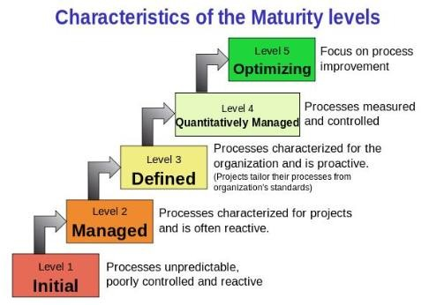
CMM
There are five maturity levels as shown below…
Initial
Managed
Defined
Quantitatively Managed
Optimizing

Slide 45
CMM
Maturity levels consist of a predefined set of process areas. The maturity levels are measured by the achievement of the specific and generic goals that apply to each predefined set of process areas.
Maturity Level 1 – Initial: Company has no standard process for software development. Nor does it have a project-tracking system that enables developers to predict costs or finish dates with any accuracy.
Maturity Level 2 – Managed: Company has installed basic software management processes and controls. But there is no consistency or coordination among different groups.

Slide 46
CMM
Maturity Level 3 – Defined: Company has pulled together a standard set of processes and controls for the entire organization so that developers can move between projects more easily and customers can begin to get consistency from different groups.
Maturity Level 4 – Quantitatively Managed: In addition to implementing standard processes, company has installed systems to measure the quality of those processes across all projects.
Maturity Level 5 – Optimizing: Company has accomplished all of the above and can now begin to see patterns in performance over time, so it can tweak its processes in order to improve productivity and reduce defects in software development across the entire organization.

Slide 47
Capability Maturity Model Integration (CMMI)
The CMMI helps organizations streamline process improvement, encouraging a productive, efficient culture that decreases risks in software, product and service development.
It starts with an appraisal process that evaluates three specific areas:
process and service development,
service establishment and management, and
product and service acquisition.

Slide 48
CMMI
It’s designed to help improve performance by providing businesses with everything they need to consistently develop better products and services.
But the CMMI is more than a process model; it’s also a behavioral model.
Businesses can use the CMMI to tackle the logistics of improving performance by developing measurable benchmarks, but it can also create a structure for encouraging productive, efficient behavior throughout the organization

Slide 49
Standard CMMI Appraisal Method for Process Improvement (SCAMPI)
SCAMPI is the official appraisal method used by the CMMI institute.
It is outlined in the SCAMPI Method Definition Document, which is included in the CMMI appraisal reference documents.
The goal of the CMMI is to create reliable environments, where products, services and departments are proactive, efficient and productive.
There are three appraisal classes: Class A, B and C.

Slide 50
SCAMPI A
The most rigorous appraisal method, SCAMPI A is most useful after multiple processes have been implemented.
It provides a benchmark for businesses and is the only level that results in an official rating.
It must be performed by a certified lead appraiser, who is part of the on-site appraisal team.

Slide 51
SCAMPI B
This appraisal is less formal than SCAMPI A; it helps find a target CMMI maturity level, predict success for evaluated practices and give the business a better idea of where they stand in the maturity process.

Slide 52
SCAMPI C
This appraisal method is shorter, more flexible and less expensive than Class A or B.
It’s designed to quickly assess a business’s established practices and how those will integrate or align with CMMI practices.
It can be used at a high-level or micro-level, to address organizational issues or smaller process or departmental issues.
It involves more risk than Class A or B, but it’s more cost-effective.

Slide 53
CMMI’s five Maturity Levels
Initial - Processes are viewed as unpredictable and reactive. At this stage,
“work gets completed but it’s often delayed and over budget.”
Managed: There’s a level of project management achieved. Projects are “planned, performed, measured and controlled” at this level, but there are still a lot of issues to address.
Defined: At this stage, organizations are more proactive than reactive. There’s a set of “organization-wide standards” to “provide guidance across projects, programs and portfolios.”

Slide 54
…CMMI Levels
Quantitatively managed: This stage is more measured and controlled. The organization is working off quantitative data to determine predictable processes that align with stakeholder needs. The business is ahead of risks, with more data-driven insight into process deficiencies.
Optimizing: Here, an organization’s processes are stable and flexible. At this final stage, an organization will be in constant state of improving and responding to changes or other opportunities. The organization is stable, which allows for more “agility and innovation,” in a predictable environment.

Slide 55
People Capability Maturity Model (PCMM)
PCMM is a maturity structure that focuses on continuously improving the
management and development of the human assets of an organization.
It defines an evolutionary improvement path from Adhoc, inconsistently performed practices, to a mature, disciplined, and continuously improving the development of the knowledge, skills, and motivation of the workforce that enhances strategic business performance.
PCMM is a framework that helps the organization successfully address their critical people issues

Slide 56
Personal Software Process (PSP)
PSP is a series of defined processes that allow software engineers to produce high-quality products on time and within budget.
PSP shows engineers how to:
Manage the quality of their projects
Make commitments they can meet
Improve estimating and planning
Reduce defects in their products

Slide 57
Team Software Process (TSP)
TSP along with the Personal Software Process helps the high-performance engineer to:
Ensure quality software products
Create secure software products
Improve process management in an organization.

Slide 58
Many thanks

